Slide 1

1st REVIEW
SMART LEAVE MANAGEMENT SYSTEM
RAYANKI HIMAVARSHINI | 2520030141
GURRAPU NIKSHITHA | 2520030512
VEMUA NAGA VENKATA SAI CHANDU | 2520030522
Under the Guidance
of
Dr. Spandana
Assistant Professor
Department of Computer Science and Engineering
KONERU LAKSHMAIAH EDUCATION FOUNDATION

Slide 2

GROUP NUMBER: __
Name of Candidate | Role
RAYANKI HIMAVARSHINI | Team Lead & Backend / Database Developer – Java, Spring Boot
GURRAPU NIKSHITHA | Frontend Developer – React, HTML, CSS
VEMUA NAGA VENKATA SAI CHANDU | Integration & Testing Developer
2

Slide 3
ABSTRACT
Web application that simplifies and automates employee leave management.
Employees register, log in, apply for leave, choose the leave type and track request status.
Managers review requests and approve or reject them through an approval workflow.
Leave balances update automatically and a complete leave history is maintained.
Built with React (frontend), Java and Spring Boot (backend) and MySQL (database).
Reduces paperwork and delays for a transparent, accurate and reliable process.
3

Slide 4
INTRODUCTION
A web-based system that makes leave management simple, fast and transparent.
Employees apply for leave online and check their leave balance at any time.
Managers approve or reject requests and can add remarks.
React is used for the frontend, Java and Spring Boot for backend services, and MySQL for data.
Includes leave types, leave balances, approval workflow and leave history.
4

Slide 5
EXISTING SYSTEM
Manual leave requests through paper forms, emails or messages
Leave balances maintained in registers or spreadsheets
Delay in approval and no way to track request status
Errors in calculating leave balance
No proper leave history or records
Difficult for managers to see who is on leave
Limited reporting features
5

Slide 6
PROBLEM
Manual leave handling is slow, error-prone and difficult to track.
Employees do not know their leave balance or request status.
Managers lose time collecting, checking and approving requests.
Records get lost or become inconsistent, so past leave cannot be verified.
A system is needed with leave types, automatic balances, a clear approval workflow and history.
6

Slide 7
SOLUTION (Contribution)
An online platform for applying for, approving and tracking leave.
Supports multiple leave types such as casual, sick, earned and emergency leave.
Leave balances are updated automatically after every approval.
Managers approve or reject requests through a simple workflow.
Maintains complete leave history for employees and managers.
Reduces manual work and improves transparency.
7

Slide 8
Objectives
To develop a simple and user-friendly leave management system.
To allow employees to apply for leave and check leave balances online.
To provide an approval workflow for managers to approve or reject requests.
To manage different leave types and update balances automatically.
To maintain complete leave history for tracking and reporting.
8

Slide 9
Modules
Employee Module – Registration, login, profile management and viewing leave balance.
Leave Type Module – Define leave types and the number of days allowed for each.
Leave Request Module – Apply for leave, select dates and leave type, cancel pending requests.
Approval Workflow Module – Managers approve or reject requests with remarks.
History Module – View past leave records, status and balance changes.
9

Slide 10
SOFTWARE REQUIREMENTS
Frontend – React.js, HTML, CSS
Backend – Java & Spring Boot
Database – MySQL
Operating System – Windows / Linux
Development Environment – VS Code / IntelliJ IDEA
Web Browser – Google Chrome / Microsoft Edge
10

Slide 11
SYSTEM ARCHITECTURE
React sends REST requests
Spring Boot handles leave and approval logic
MySQL stores employees, balances and history
React.js
Frontend UI
Employees & Managers
Spring Boot
Java REST APIs
Leave logic
MySQL
Employees, leave types,
balances, requests
REST
11

Slide 12
LEAVE WORKFLOW
Employee logs in and opens the Apply Leave page.
Selects leave type, dates and enters the reason.
System checks the leave balance and saves the request as PENDING.
Manager views the pending request.
Manager approves or rejects it with remarks.
On approval the balance is reduced and the history is updated.
12

Slide 13
DATABASE DESIGN
EMPLOYEES
LEAVE_TYPES
LEAVE_BALANCES
LEAVE_REQUESTS
PK id
name
email
role
manager_id
PK id
type_name
max_days
PK id
FK employee_id
FK leave_type_id
balance
PK id
FK employee_id
FK leave_type_id
from_date / to_date
status
remarks
PK = primary key, FK = foreign key. One employee has many leave requests and balances; one leave type has many requests. Leave history is built from the requests table.
13

Slide 14
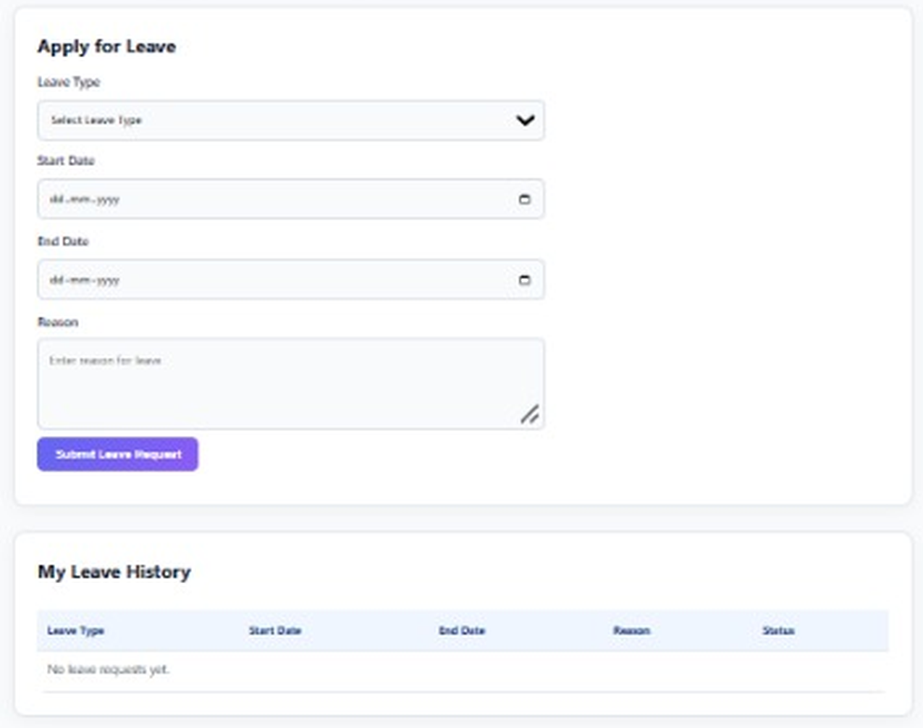
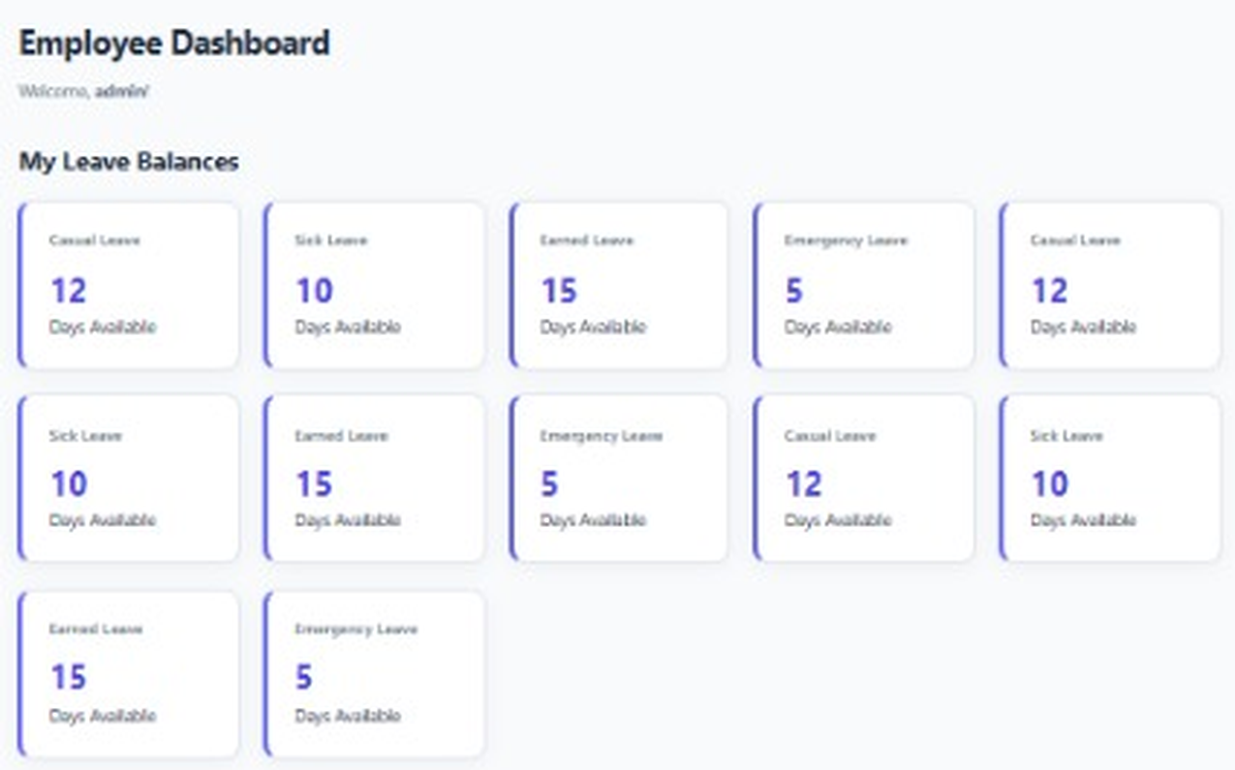
APPLICATION SCREENS
Employee dashboard: leave balances (left), apply for leave and leave history (right)
14

Slide 15
CONCLUSION
One online platform to apply for, approve and track leave.
Automatic leave balances avoid calculation errors.
The approval workflow speeds up decisions for managers.
Leave history gives complete and reliable records.
The result is a simple, transparent and efficient leave management system.
15

Slide 16
FUTURE SCOPE
Mobile application for Android and iOS.
Email and SMS notifications for requests and approvals.
Leave calendar showing the whole team’s availability.
Holiday calendar and automatic leave carry-forward.
Reports and analytics for managers and HR.
Stronger authentication and role-based access.
16

Slide 17
THANK YOU

